Slide 1
Ms. Calabrese
9th Grade Counselor
Student Success Skills – Study Tips & Organization
http://counselorcalabrese.weebly.com

Slide 2
Questions to Think About
How has your attendance been each year?
How do you feel about homework?
How much time do you spend studying each day?
Do you use notebooks? How?
What happens after a teacher gives you notes or tells you to read a chapter?
What book are you reading right now?

Slide 3
Attendance
If you’re not in class, you don’t get to hear what’s important and you miss work.
Remember that what you did in a year in middle school, you’re doing in half a year in high school.
More than 8 absences (no matter what kind) = Failure
To be promoted to the next grade…

Slide 4
Are You An Effective Learner?
I check homework, make sure it’s neat, and put my name on it before turning it in.
I know how to study – NOT look over notes, but really study.
I review a subject even if I don’t have an exam or test this week.
If I am having problems with a subject, I talk them over with my teacher early.
I get my homework done as early as possible without distractions.
I read all the comments and suggestions my teacher might make about my work.
I make flashcards for all the vocabulary used in each subject.
I have a folder on my desktop for each class with all notes and assignments*.
I plan my time by writing down everything I have to do and by what time.
I know some tricks for how to memorize facts.
I never wait until the night before a test or quiz to study.
I am involved in other activities besides just attending school.
I attend class regularly and am never tardy to school/class.
When I have to be absent, I request my work immediately by email and check Haiku. Then, I turn in all makeup work.
Notes:
Study Habit Test!
Be Honest! Don’t comment. Just answer on paper or laptop.
We’ll come back to this later.

Slide 5

Which one are YOU?
Created by Terese Ewing
Notes:
Studies show that it takes about 28 days to form a new habit.
I’m here to teach you all some strategies to help you form better study habits and test-taking skills!

Slide 6
So, what’s in it for me?
Makes learning easier
Standardized tests are easier
Look forward to coming to class
Learn memory strategies to help remember facts
Learn to manage anxiety so you can perform better under pressure
Have better relationships with peers
Be happier and healthier

Slide 7
Key to Healthy Optimism
Don’t doubt your ability
Doubt your strategy
If what you’re doing is not working…
Try Something Different!!!

Slide 8

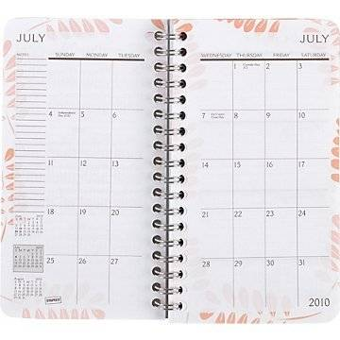

Getting Organized
Folders for each subject on your desktop*
Write assignments and due dates as soon as you get them
Lay out clothes, school stuff the night before
Set a time and place aside for homework/studying
Don’t wait until the night before to study or do a project

Slide 9

Studying
Do homework when assigned
Review notes DAILY
  Read
  Recopy
  Make flashcards
    www.studyblue.com
    www.quizlet.com
Summarize reading in your own words
Mnemonic devices (next slide)
Repeat out loud
Have someone quiz you
Make your own test

Slide 10

Mnemonic Devices
Ways to help you remember
Words or sentences
  Great Lakes: HOMES
  Colors of spectrum: ROY G. BIV
  Order of operations: Please Excuse My Dear Aunt Sally
  Planets: My Very Educated Mother Just Served Us Nine Pizzas.
Rhymes
  In ____, Columbus sailed the ocean blue
Notes:
HOMES – Huron, Ontario, Michigan, Erie Superior
PEMDAS – parenthesis, exponents, multiplication, division, addition subtraction
MVEMJSUNP – Mercury, Venus, Earth, Mars, Jupiter, Saturn, Uranus, Neptune, Pluto (no longer a planet)

Slide 11


Taking Notes
If a teacher writes it the on board, repeats it, or says it’s important, WRITE IT DOWN!
PUT IN YOUR NOTEBOOK (or folder on desktop)
Listen carefully!
Write examples and page numbers (if applicable)

Slide 12
Boosting Memory: Index Cards
Create index cards using the “Most Important Ideas” (from outlines, concept maps)
Ask teachers to provide a few examples of effective index cards related to the upcoming test.
Review note cards several times before the test.

Slide 13
Your Own Personal Studying Technique
Tie something you like into studying – listen to music, sit outside, chew gum – do what works best for you.

Slide 14

Calm Place
Find your Happy Place

Slide 15

Breathe, Picture, Focus
Breathe in slowly to count of 5, hold for count of 5, exhale to count of 5
Picture yourself in your “Calm Place”
Focus on your strategy for the task at hand

Slide 16

Don’t Stress Out!!

Slide 17

Taking Tests
Don’t wait until night before to study
Sleep well and eat beforehand
Read questions carefully.
Answer questions you know first, then go back to the others
Write neatly
Check over test before turning it in!

Slide 18
Seven Test Taking Strategies
Use slow breathing to relax.
If you begin to get too anxious, repeat slow breathing and picture your “Calm place” for a moment to break the stress cycle. Focus on your test taking strategy.
Look over the entire test to determine how long it is and where the most points are. Determine a time limit for each section.
If you use acronyms, or other memory aids write them down on a scratch piece of paper.
Answer the easy questions first. Often these questions will have clues to harder questions.
Go back to the harder questions. Look for clues. Eliminate any obvious wrong answers. If you are still not sure of the correct answer take your best educated guess.
Budget your time so that you have a few minutes left at the end to check your answers. Make sure you do not leave any blank.

Slide 19
Remember – Optimism!
Don’t doubt your ability
Doubt your strategy
If what you’re doing is not working…
Try Something Different!!!

Slide 20
Why does it even matter?
What is GPA?
Why college?
Where do I start?

Slide 21
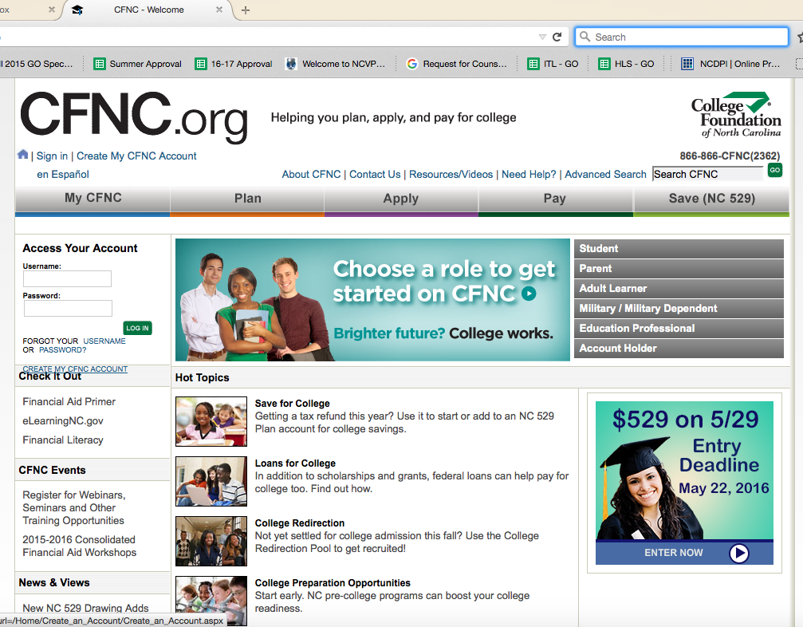
Setting up a CFNC.ORG Account

Slide 22
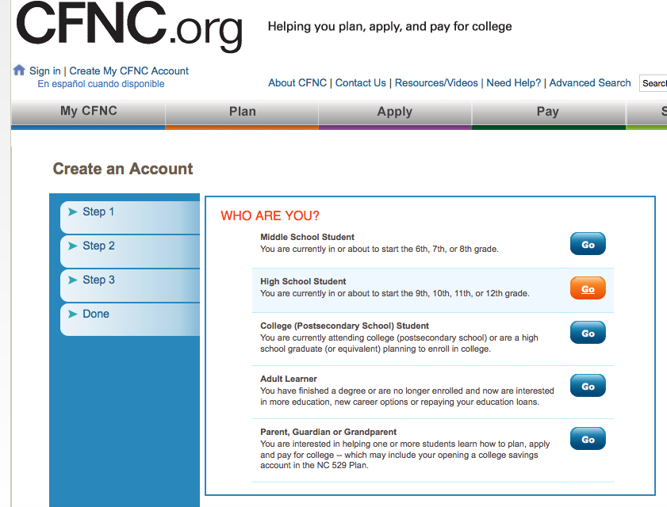
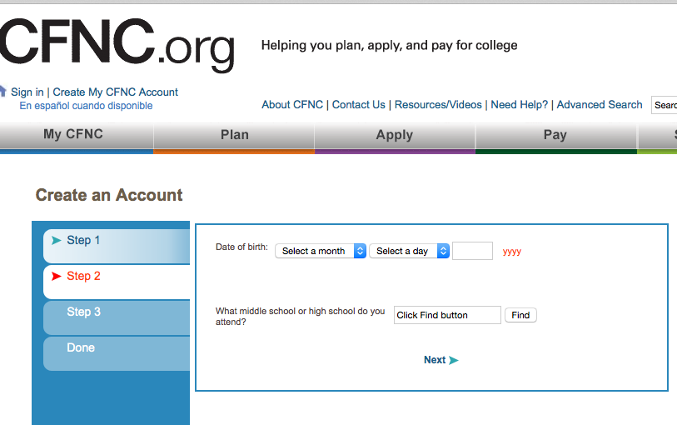

Slide 23
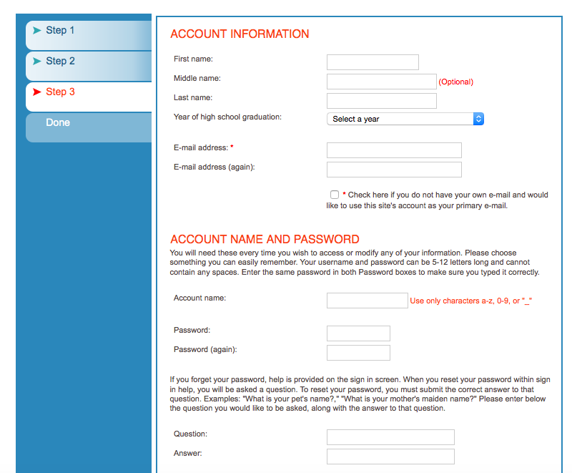
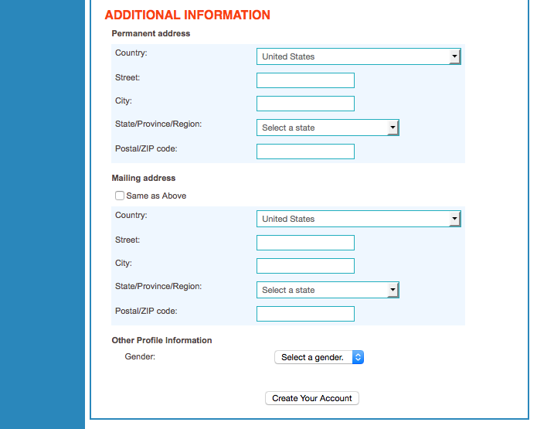

Slide 24
Advice From Your Upperclassmen
Every grade counts starting in 9th grade!
Join clubs to build up your resume
Hang out with people who have the same goals as you
Embrace yourself – learn who you are
You’ll lose friends, but don’t let it define who you are
Every class matters!
Don’t procrastinate – do your work as you get it
Build relationships with your teachers
Talk to your counselors
Just because everyone else is doing something doesn’t mean you have to
Teachers are there to help you, not hurt you
Turn in your work on time and do the best you can your first year
Do the work and keep your grades up because it affects you next semester and the years to come
High school isn’t that hard if you try your best
Turn in your work on time and ask for help if you need it
Keep your work up even though you get tired of school, because its going to benefit you in the long run
I wish that I knew more about the clubs.
Do your best in class and try to pass
Be yourself - don't feel like you have to impress others and just be comfortable being you
Do your work and hand it on time. It might be a lot of work but it will work out
Show up to school, complete your work and give 100%
Join clubs because once you're a senior it'll be too late
Have their work done
Keep up with everything that you need to keep your grades up. It may seem hard when you first enter high school, but once you pay attention it's actually really easy
I would advise all freshmen to NOT let your grades slip and ALWAYS keep check on your grades by asking your teacher
Join clubs and stay on top of your work because every year counts - especially freshman year
Be yourself, you don't have to feel like you have to be somebody else to impress other people
Stay on top of your work to start off good with a high GPA because if you get behind, it is hard to bring it back up
Make everything you do count
Have good grades the first year and every year for your GPA
Join clubs
Keep your head up

